Slide 1
What’s new about the
2019 edition of the CPMS?
Notes:
Facilitators:
This briefing is for people who have used the 2012 edition of the CPMS. It is geared primarily toward child protection staff, so consider broadening some questions or providing more detail, if colleagues from other sectors join you.
It is assumed that the group is about 20 people and that everyone in the room knows each other (perhaps colleagues from your agency or the CP coordination group). if not, add 5 minutes for quick introductions.
PREPARE: a flipchart with the objectives of the session
Learn about the updates to the 2012 edition
Feel confident to trade in your 2012 edition and instead use the 2019 edition, especially with non-child protection actors
This is not an in-depth training. The final activity is for your audience to identify next steps. At that time, you may decide to hold a one-day workshop to examine a specific standard; or ask senior programmers to reflect together on implications for a specific thread of work; or you may want to re-visit a grant proposal that is being written; or review your accountability mechanisms; etc
The session runs for 60 minutes; timing is tight but you can drop one of the activities if you are running over time. Equally, if your participants have been very involved with the CPMS and/or review process, you may want to skip over Slides 2-5.
All you need is the PPT, the 2 page briefing note [“What’s New”] – one copy for each participant; flipchart & markers for the facilitator.
A copy of the 2019 edition for each person is a bonus; however as a facilitator, you should have a copy to prepare for and circulate during the session. Participants could look at the online version or app.
You must have a good level of familiarity with the 2019 edition. Feel free to contact us before (or after) your session with any questions: cpms.wg@alliancecpha.org
-------------------------------
00:00 [Time when slide starts / how many minutes into the presentation]
SAY: Welcome & explain the objectives of the session
If you know the group well, ASK: “What standard have you never used?” and / or “what standard do you find most interesting – even if you don’t use it in your work? Why?” --- OR ----
If you don’t know the group that well, ASK: “What are the 2 standards you use the most in the CPMS?”
Either way, do a quick round of the complete group (if time allows) and tally the points on a flipchart to see what areas of CP work they focus on/don’t use/interests them.

Slide 2
2012 edition
Hugely popular
74 000 users in 50+ countries
14 translations
18 countries contextualised/adapted it
2nd most downloaded set of standards on HSP app
Notes:
00:05
SAY:
It’s hard to estimate how many people have used the CPMS as anyone can download the document and the app, or navigate the online version.
The translations range from Russian to Chinese; from Urdu to Japanese.

Slide 3
2012 edition
However, there were gaps…
Some core principles were sidelined
Needed more comprehensive and realistic measurement
More emphasis was needed on:
The role of local actors
Accountability and inclusion
Prevention
Integration and collaboration across sectors
Updates needed on effective interventions and Cross-cutting issues had evolved
Cash and voucher assistance
Gender & LGTBI issues
Environmental concerns
Mobile programming
Notes:
00:07
SAY: By 2017, it was clear that there were gaps too.
If your group has used the CPMS daily/weekly ASK: “For those of you who have used the initial edition of the CPMS, what are some of your criticisms of it?”
Then CLICK to the full slide and
SAY: On the slide are the main gaps that were noted through a global survey of child protection staff. You will see some of the ones we just discussed.
[Facilitators: going through each one will take time, so just put the slide up and have people read it for 1 minute and then highlight 1 or 2 that are particularly relevant for your context. See below.]
OR
If your group has used the CPMS occasionally, CLICK straight away to the full slide and spend more time on each line that is most relevant to your context.
Background for each point:
The 4 Principles that were adopted from the CRC were not listed directly under the CPMS Principles and thus, were sometimes seen as something different or even forgotten.
Practitioners were eager to have a comprehensive list of indicators and more realistic measurement overall (this is reflected with an additional online table of indicators).
Since the 2012 CPMS, the Alliance has given greater focus to localising Child Protection in humanitarian action.
The Core Humanitarian Standard and many similar tools continue to challenge us to consider how to live up to this principle
The 2012 edition gave very little consideration to how humanitarian actors could prevent specific child protection risks from occurring.
Pillar 4 had focused on mainstreaming, but it was felt that other approaches needed to be strengthened as clear options.
Cash and voucher assistance has expanded hugely in the past 7 years. There is increasing evidence and guidance on how to ensure positive impacts on children’s protection.
There was a sense that issues around gender norms and the rights of children who identify as lesbian, gay, transgender, bisexual or intersex needed to be sensitively addressed throughout this key piece of work
With the growing climate crisis, practitioners wanted guidance on how to include this in their analysis and where possible, programming too
Children are on the move; urban areas cannot necessarily be repurposed as quickly as new camp settings – mobile programming had received little attention in the 2012 edition and yet has great potential as one approach to service delivery
ALL FACILITATORS SAY: Constantly updating the collective evidence base drives up the quality of our programming, communication, advocacy, monitoring, evaluation, and learning. Once these gaps were identified, the global Alliance for Child Protection in Humanitarian Action – which is the guardian of the CPMS – decided to start a revision process.

Slide 4
2012 edition
It needed to be applicable to wider range of contexts
Children and families who are refugees, displaced, or in migration contexts
Infectious disease settings
Urban areas
Dangers and opportunities of internet/ information technology to protect children
Notes:
00:10
SAY: It’s a rapidly changing context in which children are living and in which humanitarian disasters occur.
There are more children who are refugees, stateless, internally displaced or on the move then ever before. They are travelling alone, with families, with distant members of their community. Their reception is not always welcoming and there are many sorts of barriers. They may be struggling for survival, development and protection and yet lack access to systems and services that should help them.
The 2014-2016 Ebola crisis in West Africa pointed to some key weaknesses in the child protection response. The Alliance commissioned a piece of research and wove the findings into the 2019 edition.
Increasingly children – including refugees, stateless and displaced children live in urban areas. Urbanization can bring particular risks of isolation, spread of disease, being targeted as foreign or other, etc.
The internet, cash transfers by phone, social media seem to be everywhere. They raise the question of how do we harness fast-evolving technology to better protect children in humanitarian contexts? Who do we need to be working more closely with? What are some of the protection risks and ethical concerns attached to the use of technology and information management (e.g. concerns re: data privacy and protection)? These areas all require careful reflection and adaptation on the part of humanitarian actors.
if there is time, ASK: Does anyone want to share an example of how the context has shifted here?

Slide 5
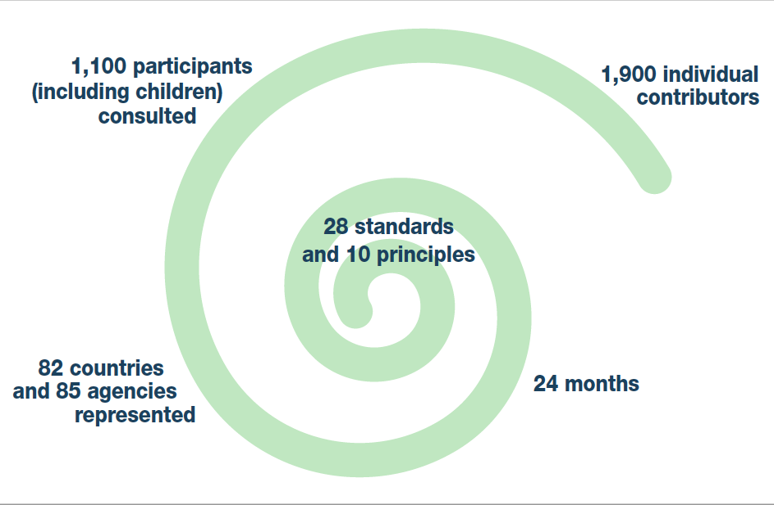
The
revision process
Expert teams reworked each standard, which went out for country level and global consultations
Notes:
00:12
SAY:
The revision was a 2 year process
1900 people participated in revision groups or the online consultation or were some of the 1100 people who gathered country by country to discuss different draft standards in the summer of 2018. Most were child protection staff, including 150 officials with the local authorities.
In addition, sessions were organised with more than 300 children and caregivers in Kenya, Syria, & Armenia.
There were 6 full drafts and many more drafts of individual standards.

Slide 6
Introducing the 2019 edition
Notes:
SAY: So here it is - the same great handbook – and yes, a tiny bit longer and heavier!

Slide 7
2019 edition
Things to remember as we explore the 2019 edition
These global standards continue to provide a benchmark for CPHA.
Contextualisation of the CPMS is encouraged and can create ownership of the standards at every level.
Notes:
00:14
SAY:
Donors, local governments, colleagues in other sectors and our beneficiaries themselves want to know what we are doing and why. The CPMS is our benchmark. The rollout of the 2019 edition is eager to forefront our accountability – particularly to children.
Contextualisation was often a long and detailed process that built a deeper understanding of child protection in the specific context for a wide range of actors; but occasionally it was light touch and very fast. National coordination groups are encouraged to adapt the 2019 edition over the coming years. Please raise it with colleagues locally and then seek the guidance of the global CPMS team.

Slide 8
2019 edition
Connections to other standards & initiatives
The CPMS remain a collaborative, inter-agency tool, making links with new initiatives, such as the Core Humanitarian Standard, INSPIRE and the Humanitarian Inclusion Standards.
Notes:
00:16
SAY:
85 agencies were involved in the revision process. This edition wasn’t possible without that high level of effort and ultimately, commitment to use the document. Our agency endorses the CPMS and all staff are expected to use it a central guidance tool.
Wherever relevant, the CPMS aligned with INSPIRE’s 7 strategies to end violence against children – and you will see that initiative’s icons scattered through this text. The Core Humanitarian Standard on Quality and Accountability is highlighted in the Introduction but resonates throughout the handbook.

Slide 9
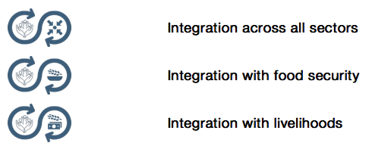
2019 edition
The same great design
The colour coding is the same,
the tabs to find things
The spiral binding
But we added icons to remind us of connections to make & cross-cutting issues to consider
Notes:
00:17
SAY: We really felt that the 2012 structure and design has stood the test of time
READ OUT the slide and show people using your copy of the handbook/ app/online version.
SAY: We want people to understand that while the content has been updated, the structure and design will feel familiar.

Slide 10
Guess the icon
2019 edition
The same great design
Notes:
00:18 - Quick guessing game
SAY: When I click on an icon, tell me what you think it means.
CLICK one and have people answer until the correct one is stated. Go to the next one.
Displacement
Case management
Early childhood
Adolescence
Infectious disease outbreaks
Indicators
Safeguarding
Prevention
The next page has the whole table for people to see

Slide 11
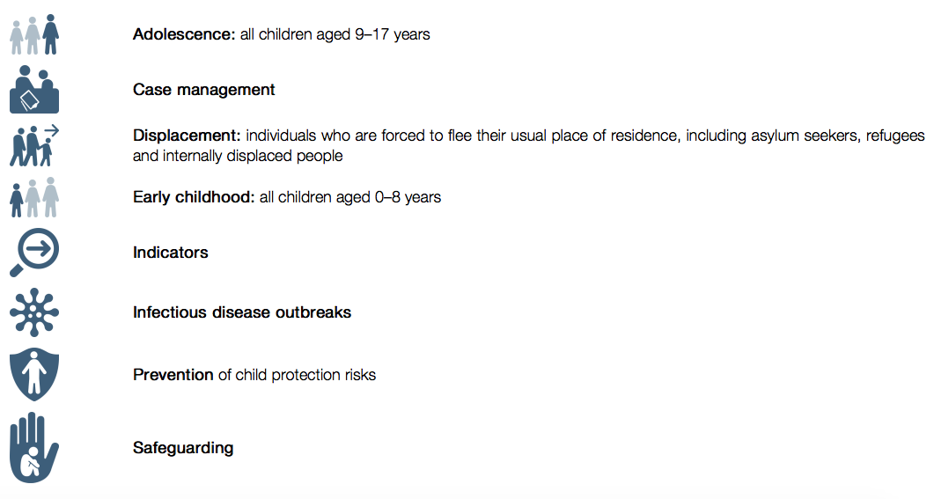
2019 edition
The same great design
Look out for icons as you review the 2019 edition! Consider: what do these mean for your ways of working?
Notes:
00:20
SAY: These are the answers to the quiz.
Then CLICK again – a box pops up.
SAY: Remember to look out for the cross-cutting icons throughout the handbook and consider what they mean for how we work.

Slide 12
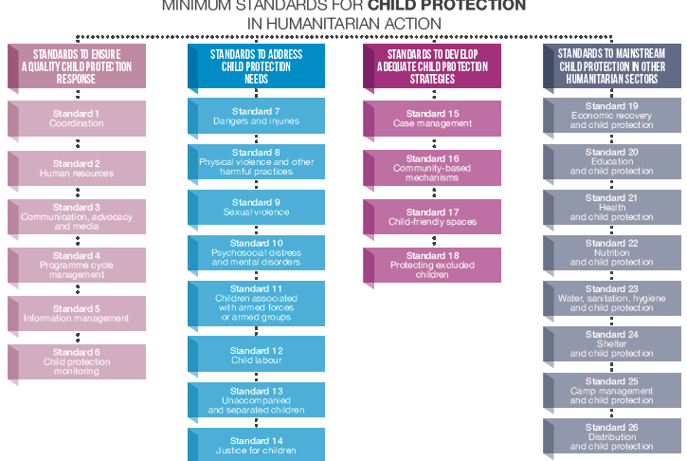
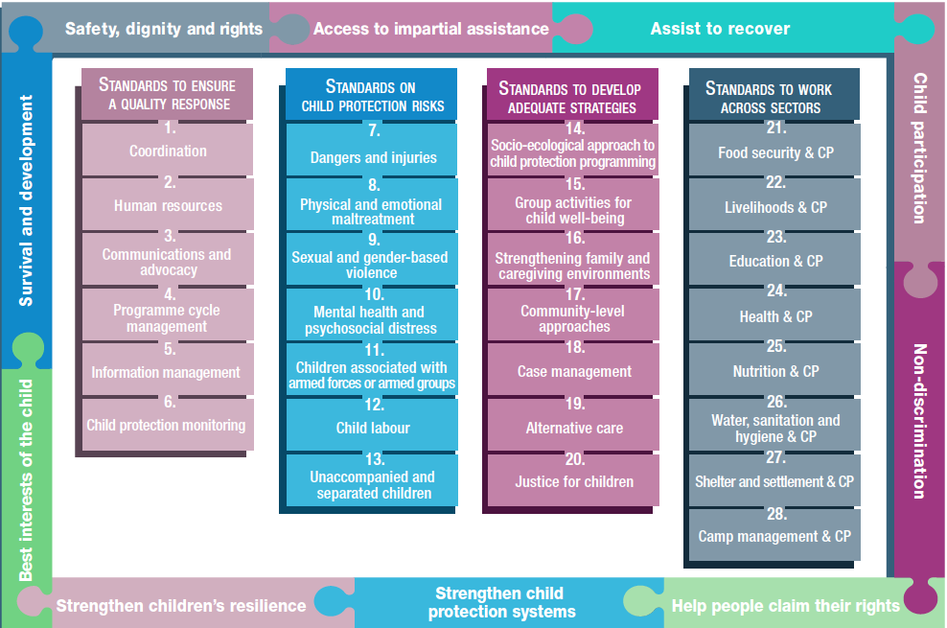
2012 edition
2019 edition
Notes:
00:21
SAY: So now to the content! This is the 2012 CPMS that we know and love.
CLICK
SAY: This is 2019 edition – 28 Standards across the same 4 pillars and with our 10 principles threaded throughout

Slide 13
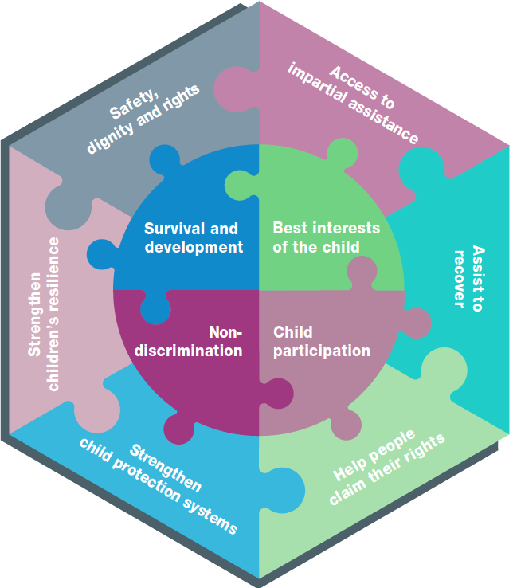
2019 edition
Our 10 Principles
Haven’t changed but…
All 10 are grouped together as equals
Woven into each standard as a reminder
Notes:
00:23
SAY: Our 10 Principles have not changed. We have added some concrete applications to explain them. All 10 have been grouped in one section with equal weight. But they are also highlighted under each standard and hyperlinked so you can easily go back and check on them in the online version and app.
ASK: Can anyone name all or some of the 10 Principles that guide our work?
Answer:
Survival and Development (UNCRC)
Non-discrimination and inclusion (UNCRC)
Children’s Participation (UNCRC)
The Best Interests of the Child (UNCRC)
Enhance people’s safety, dignity and rights, and avoid exposing them to further harm (Sphere)
Ensure people’s access to impartial assistance according to need and without discrimination (Sphere)
Assist people to recover from the physical and psychological effects of violence, coercion or deliberate deprivation (Sphere)
Help people to reclaim their rights (Sphere)
Strengthen child protection systems (created for the CPMS)
Strengthen children’s resilience in humanitarian action (created for the CPMS)

Slide 14
2019 edition
Overall introduction
Provides deeper explanation of
Child Protection in Humanitarian Action
Its international legal basis
The CPMS - who they are for, how they were developed, how to use them
Connections with other standards
Cross-cutting issues
Notes:
00:25
READ out the slide
SAY: It is an excellent overview for new staff or development colleagues [feel free to add any colleagues or actors in your context]

Slide 15
Pillar 1 – to ensure a quality response
Standard 1: coordination in both cluster and refugee settings
Standard 4 : Stronger child development and protection lens
Standard 5: significant update to reflect new IM tools and ethical concerns
Throughout: Stronger emphasis on child safeguarding and PSEA
Notes:
00:26
READ OUT
SAY: Standard 1is worth some extra explanation. The global CP AoR & UNHCR jointly drafted this standard. It clearly explains what to expect and how to get involved in coordination structures in these two rather different contexts.
Equally, the CPMS highlights the importance of child safeguarding and the prevention of sexual exploitation and abuse and now flags them throughout the documents with the use of specific icon

Slide 16
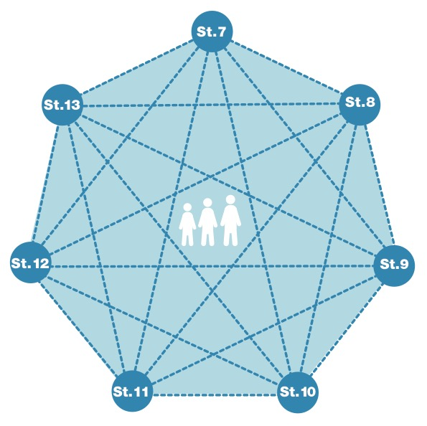
Pillar 2 – child protection risks
Notes:
00:28
SAY: Before delving into the changes to this pillar, let’s stress the interconnected nature of the standards. It’s one child after all; one family’s life that we are trying to assist.

Slide 17
Pillar 2 – child protection risks
Standard 8 : Physical and emotional maltreament
Neglect + Emotional Abuse
Reflecting the new evidence
Standard 9 : Includes broader gender-based violence:
Reflects gender inequality as root cause
Social and gender norms change where possible
Strengthens survivor-centered approach
Notes:
00:29
SAY:
Standard 8: Physical and emotional maltreatment: This standard expands the focus from the 2012 edition which focused primarily on physical violence and did not fully consider physical and emotional neglect or emotional abuse. It builds on new guidance and research from the INSPIRE Handbook, the World Health Organisation, and the Alliance’s on research on child neglect in humanitarian settings. It emphasizes the serious short and long-term, negative impacts on children of physical and emotional maltreatment in a range of settings, and provides guidance on prevention and coordinated response.
Standard 9: Sexual and gender based violence:
A broader focus on gender-based violence while also recognizing that children – both girls and boys –face particular risks and needs related to sexual violence. It acknowledges the root causes of SGBV are harmful social and gender norms that promote gender-based discrimination and unequal power; where basic SGBV services are in place and the environment is stable, interventions aimed at promoting gender equality and systemic change to social and gender norms are encouraged. It also strengthens guidance on a survivor-centred approach, confidentiality, and child marriage.

Slide 18
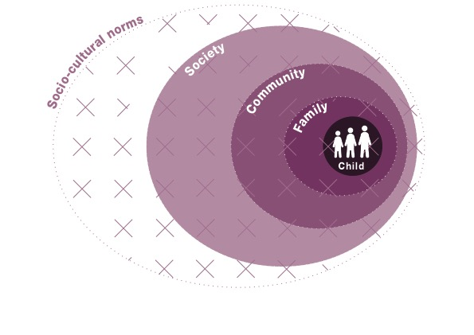
Pillar 3 – to develop adequate strategies
Framed by the socio-ecological model & systems thinking
Links with INSPIRE
Notes:
00:33
[FACILITATORS: This shift might be very familiar for your audience or something quite new, so please prepare your comments accordingly.]
SAY: The socio-ecological model provides a concrete framework that supports systems thinking for child protection programming. It looks at an entire situation to (a) identify all the different elements and factors and (b) understand how they relate to and interact with each other. Rather than looking at a single protection issue or specific service in its own, systems thinking considers the full range of problems facing the child, their root causes and the solutions available at all levels. It promotes flexible programming that integrates new learning and adapts accordingly throughout implementation.
The socio-ecological model and child protection systems thinking are complementary frameworks that seek to achieve the same goal: a holistic, integrated approach to protecting children. The INSPIRE package has a similar goal: evidence-based strategies for preventing violence against children.

Slide 19
Pillar 3 – to develop adequate strategies
New standards on
Strengthening family & caregiving environments
Alternative care
Significant updates:
Standard 15: more than CFS!
Standard 17: working towards community-led processes
Standard 20: a protective strategy!
Notes:
00:37
Go over the content
SAY:
New standards:
Standard 16: Strengthening Family and Caregiving Environments: This new Standard places the child in the heart of the family, and stresses that child protection workers must look to build on the strengths of the family, while always carefully assessing any risks to the child. It also examines what to do if infectious disease outbreaks make it difficult to stay together.
Standard 19: The stand-alone Alternative Care standard has links to Unaccompanied & Separated Children still, but also Case Management and the new Standard on Strengthening Family & Caregiving Environments.
Significant updates:
Standard 15: Group Activities for Child Well-being: Some people may be surprised that Child Friendly Spaces no longer have their own standard. But there was a feeling over-reliance on this one type of intervention, and instead it is grouped under “Group activities for child well-being” which also explores mobile programming, links to skills training, and other regular and consistent opportunities for improving children’s protection.
Standard 17: Community-level Approaches:
Many felt that we needed to move away from any top-down notions when it came to working with communities on improving protection outcomes for their children The community level approaches standard stresses that there is no “one size fits all” model. It urges us to undertake deep context analysis and patient facilitation of community-designed and community-led processes. We should always be aware of the heightened risk of weakening community when we undertake rushed interventions.
Standard 20: Justice for Children:
Finally Standard 20 was an opportunity to re-orient our understanding of what Justice for children means in the context of a humanitarian context. Through the global Working Group’s 2015 desk review, we became better aware of the many interactions that children have with the formal, informal and traditional justice systems. And that a crisis may present a unique opportunity for teams to strengthen systems that may otherwise resist change. Using the socio-ecological model, we can collaborate with the full range of actors to (a) assess the ways in which legal and justice systems at all levels either provide protection or present risks and (b) develop interventions to reinforce protection and overcome risks.

Slide 20
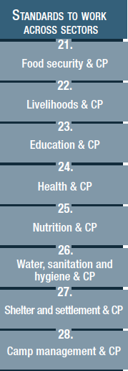
Pillar 4 – to work across sectors
Integrated approaches, joint programming and child protection mainstreaming
Increasing recognition of the Centrality of Protection across all sectors.
Highlights negative impacts of sectoral programming which is blind to child protection risks.
Notes:
00:40
SAY: This edition tries to strike a balance between specific child protection programming and closer collaboration with other sectors. That can take different forms and will vary by context. For example, integration and mainstreaming are vital approaches explored in this Pillar. However, they must be balanced with what the specific context requires. Knowing that comes from a well-rounded understanding of the strengths and needs of those children, families and protection system. In most cases, the outcome will include some elements of stand-alone child protection programming.
The need to collaborate more closely comes from an increased recognition that protection is the purpose and intended outcome of humanitarian action and must be at the centre of all preparedness and response actions. Multi-sectoral programming that intentionally includes and addresses child protection considerations contributes to higher quality impacts. This improves the outcomes for other sectors, promotes positive outcomes for children and ensures their well-being. You are all encouraged to read through the introduction to that Pillar in some detail.
ASK: Does anyone have an example of integration or a strong approach to mainstreaming child protection? If yes, Looking back now, which of the 28 standards and 10 principles had been elements of that initiative?

Slide 21
Pillar 4 – to work across sectors
New Standards:
21: Food security & CP
22: Livelihoods & CP
Integration of distribution across standards
Key Actions for:
CP actors,
other sectoral actors,
Both CP & sectoral actors together
Notes:
00:43
SAY:
Standards 21: Food Security & CP and 22: Livelihoods & CP:
This edition separates out these two areas from previous standard on economic recovery & CP as well as distribution & CP
It does so recognizing the strong links between food insecurity and CP risks (especially neglect, child marriage, and child labour); and linking with the INSPIRE standard on safe environments
The Livelihood standard links with INSPIRE standard on income and economic strengthening, Minimum Economic Recovery Standards (MERS), and focusing on strengthening families’ abilities to care for children
Integration of distribution across standards:
Recognizing that distribution is an activity that happens across multiple sectors and integrating guidance on this within each sectoral standard
Key Actions throughout the pillar were divided into what should be done by CP actors, other sector actors and what we should do together

Slide 22
Annexes
Relatively unchanged
On line:
Extensive glossary
Resource list that will be updated
Major addition - Table of indicators
Notes:
00:46
SAY: You are encouraged to look at the Alliance website for additional resources, indicators for measurement and an extensive glossary.

Slide 23
Global roll-out 2020-2021
Activity | Anticipated date
Global launch of handbook, online tool and app in English | October 15 Geneva
UK launch | November 20 London
What’s New video & first global and regional webinars | December 2019
Global launch of all materials in French, Spanish & Arabic | January / February 2020
Update of Alliance Face to Face training materials to align with 2019 edition | Early 2020
Country level support for launches, planning sessions, contextualisation | Ongoing
cpms.wg@alliancecpha.org
Notes:
00:47
SAY: This slide is just to give you a sample of what the global CPMS Working Group has planned. They are eager to hear what we are discussing and planning, and will support us however they can.
[Facilitators – do feel free to contact the co-chairs for an update on activities or go to the Alliance website for latest news.]

Slide 24
POP QUIZ!!
It’s open book; the first hand that I see gets to answer the question
Which standard do I go to if I want to find out more about foster care arrangements for refugee children?
Draw the icon for integration between CP and all other sectors.
Where can I get more information beyond the standard itself?
Under which pillar is Justice for Children?
What percentage of the deaths of children (5-14) are attributable to unintentional injury?
What is the topic of the last guidance note in the Physical and Emotional Maltreatment standard?
Notes:
00:48
[Facilitators – if you have a few minutes, try to inject some fun into the session! It helps the participants feel more comfortable with the updated handbook itself. You may not have time for all of them.]
SAY: It’s a fun pop quiz and you can use the handbook or app. The first hand that I see, gets to answer the question.
READ OUT: question 1 (answer is below). Get the correct answer and continue on.
Answers:
Standard 19 - Alternative Care
An open swirl with the hands protecting the child on the left and the coordination symbol (4 arrows pointing to a central dot) on the right
Resources section in each standard; extra readings in the annex; extra extra resources in the online annex
It’s now Standard 20 under Pillar 3 – Standards to develop adequate strategies
Over 25%- Standard 7
Confidentiality

Slide 25
Need more than the printed version?
On the Humanitarian Standards Partnership website, you will find:
http://www.humanitarianstandardspartnership.org/
Online, interactive handbook
HSP App
Downloadable PDF
On the Alliance website, you will find (links to the above and):
http://www.cpie.info/2019cpms
32 page Summary PDF
This “What’s New” Briefing Pack
Notes:
00:52
READ OUT slide
Online handbook – our greatest resource. It is found at Humanitarian Standards Partnership website
[Facilitators - if you can project from the internet, then we suggest you navigate people there and show them] http://www.humanitarianstandardspartnership.org/
The App – It is the 2nd most popular app on that site after Sphere
The PDF can be downloaded if people want to print just portions of the CPMS
On the Alliance site you will also find:
A Summary: At just 32 pages, it means that it is very topline but can be used to introduce the idea of minimum standards or start child protection discussions with government colleagues or other humanitarians without overwhelming them with the huge handbook.
The “What’s New” Briefing Pack contains this PPT and facilitation notes, plus the 2 page What’s New handout.
All materials are available on the Alliance website: http://www.cpie.info/2019cpms
[Facilitators - Printed copies – there is a small stockpile of the Handbook and Summary that the global Alliance has in Geneva; however, countries and regions are encouraged to print & manage their own copies locally. Usually, this would be done through the inter-agency Coordination structure. On request, the Alliance can share a print-ready PDF.]

Slide 26
Implications for us?
Let’s start to consider what we want to do with the 2019 edition
Thanks and now, let’s get to work with our updated tool!
Notes:
00:53
SAY: There is not much time to discuss the implications today and it is a big document to digest – even if we are only working on specific issues.
ASK: But what are your first impressions?
Facilitators: Take some individual answers and then ask people to raise their hands if they agree that this an issue/challenge/opportunity.
ASK: What should our next steps as a team be?
(i.e. you might schedule a longer meeting to digest the changes and create a plan; or ask colleagues to present certain new/revised standards and their implications for the programme; or set up a training [the Alliance F2F training package will be updated in Q1 2020] or ask Senior Management for a meeting to discuss accountability to children, etc)
00:59 CLICK: Thank you so much for coming together and starting to explore the 2019 edition. I will follow up on the next steps we discussed. And that’s the key – the CPMS is a gift that just keeps on giving every time you open it!

